Slide 1
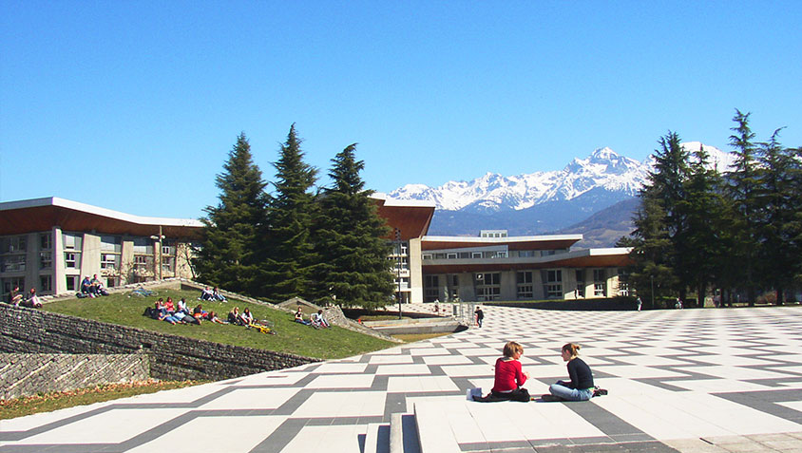

Presentation title
Write your name here
LIP/PC2S

Slide 2
Presentation title
Write your name here
LIP/PC2S
LIP/PC2S

Slide 3
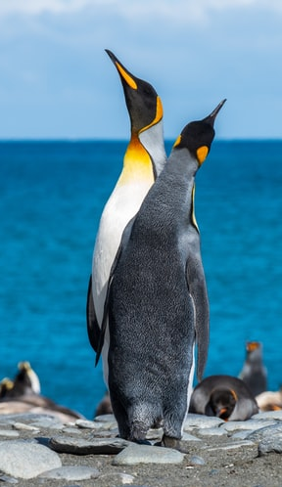

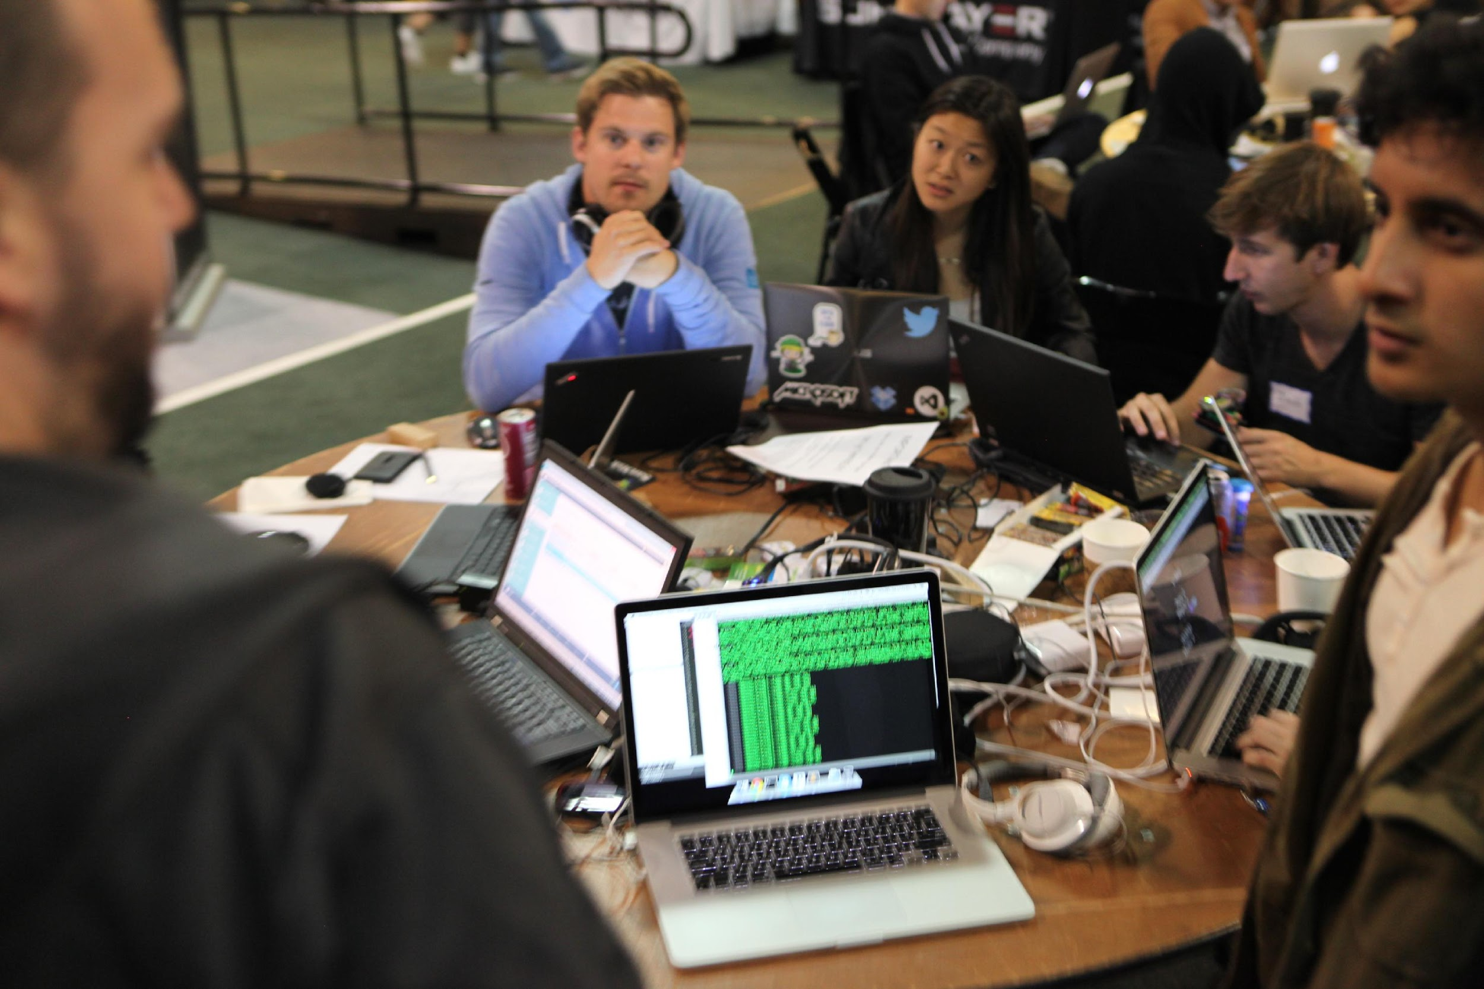




Co-regulation in romantic relationships
Social thermoregulation
Open science ideals

Slide 4
Insert each title here

Slide 5
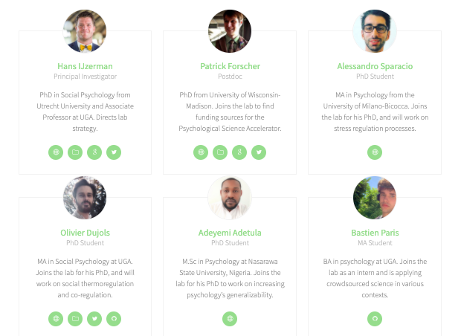
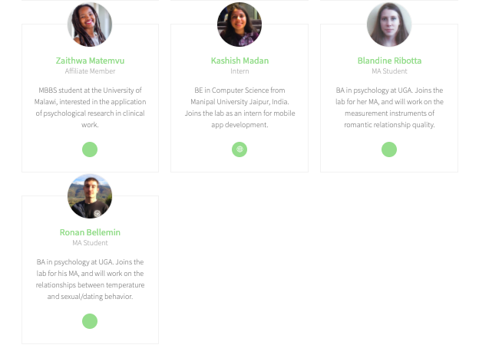
Members

Slide 6
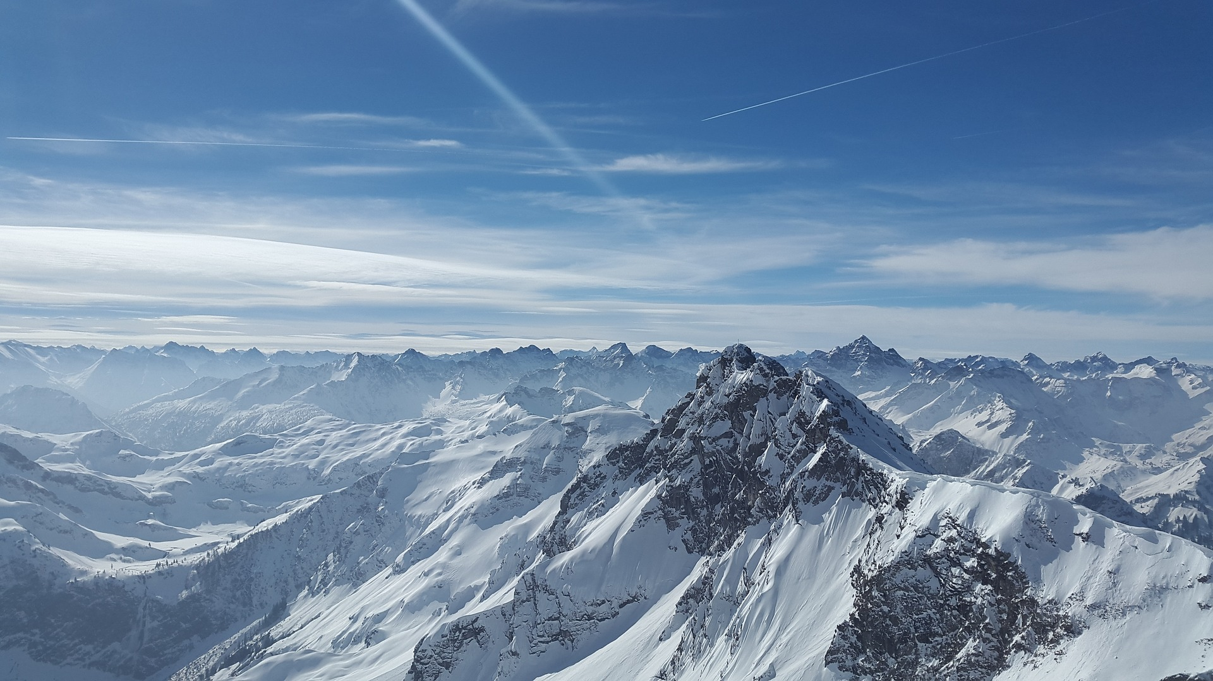


Co-Regulation (CORE) Lab.
https://corelab.io

